Slide 1
Order-to-Cash Process at Fotof
By
Iheanachor obi

Slide 2
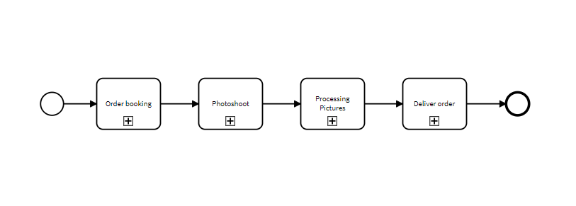
‘As-IS’ Model

Slide 3
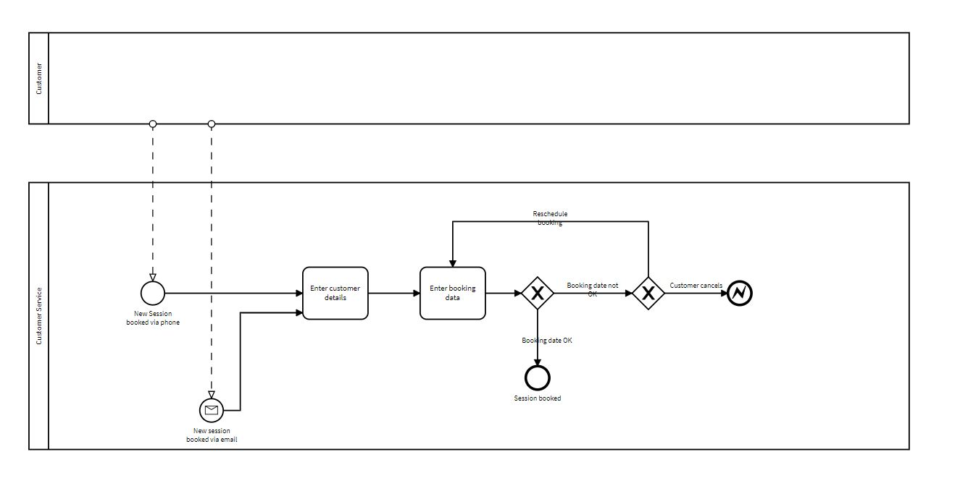
Order booking

Slide 4
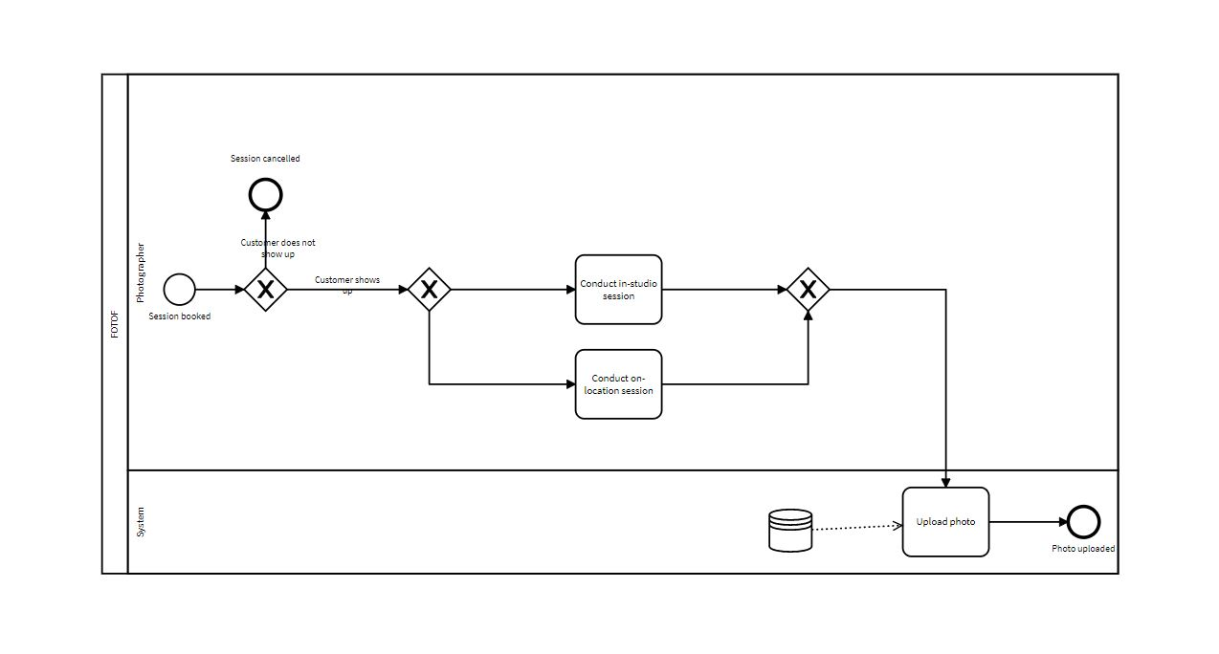
Photoshoot

Slide 5
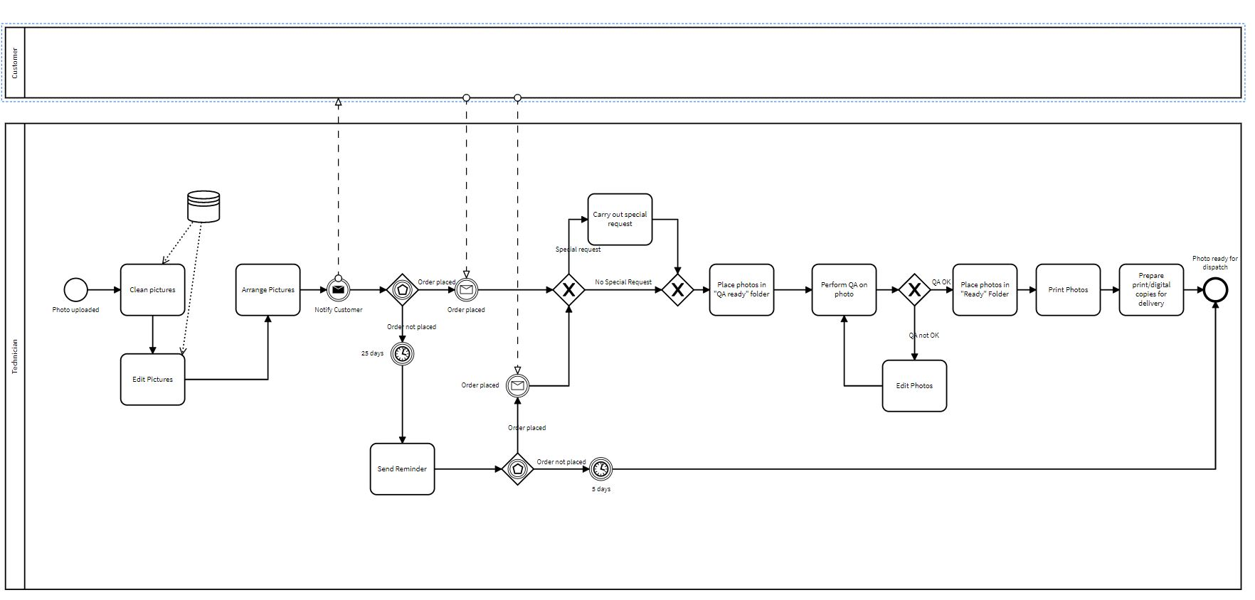
Processing pictures

Slide 6
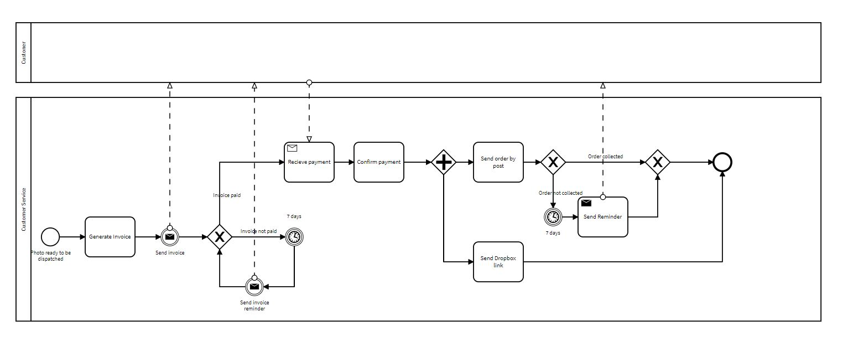
Deliver order

Slide 7
Waste analysis
Type of waste | Name | Waste Description
Transportation | Printouts and physical copy delivery | Printouts and physical copies are transported to consumers or for postal delivery, which can waste time, money, and possibly lead to damage. The transportation procedure can be made more efficient by looking into alternate delivery options or working with reputable logistics companies.
Motion | Excessive motion in managing appointments | In the process, particularly while managing appointments, there is a chance for excessive motion waste. To identify suitable appointment dates, handle modifications, and handle cancellations, customer support staff spends time on phone calls and emails. The efficiency of the employees can be increased by implementing a centralized, automated system for managing appointments.
Inventory | Unclaimed printed copies | If printed copies are not picked up by clients within a reasonable amount of time, there is a danger of inventory waste. Printouts may occasionally go uncollected for more than seven days. inventory waste can be decreased by putting in place a system to monitor and control printing inventories as well as by reminding customers when necessary.

Slide 8
Waste analysis
Type of waste | Name | Waste Description
Defects: | Quality issues in digital and printed copies | The occurrence of customer complaints related to flaws in the delivered digital and printed copies points to process defects. These defects could involve problems with photo quality, such as focus, exposure, color accuracy, or other technical aspects. To address this issue, implementing quality control measures is essential. This can be achieved through enhanced technician training and implementing a more rigorous quality assurance (QA) process. By doing so, the occurrence of defects and subsequent customer complaints can be reduced.
Overprocessing | Manual tasks and processes | The method involves numerous manual procedures and tasks that can be seen as overprocessing. For each purchase, the technician spends, as an illustration, 15 minutes cleaning up and setting up the gallery, which may include getting rid of duplicates and unsuccessful images. These processes can be made more efficient and automated to cut down on needless processing time.
Overproduction | Excessive creation of printouts and copies | If the amount of printouts or digital copies created exceeds client demand or if they are not ordered within 30 days, overproduction waste may result. Customers are invoiced a minimum billing amount in these circumstances, which could lead to waste and unforeseen costs. Waste from overproduction can be reduced by using demand-driven production and improving customer communication.

Slide 9
Issue register
Issue priority number | Issue name | Short Description | Data assumption | Qualitative Impact | Quantitative Impact
1 | High booking cancellations | High rate of booking cancellations, particularly for private orders | Cancellation rates: 1% (corporate), 5% (private); Avg. shooting fee: (€160+€120)/2=€140 | Lower revenue, wasted resources | Lost revenue = Cancellation rates * Avg. shooting fee; for corporate: 0.01 * 20K * €140 = €28K; for private: 0.05 * 180K * €140 = €1.26M
2 | High customer inquiries | High number of customer inquiries per order leading to increased workload for staff | Average inquiries per order: 3; Average time spent by customer service staff per order: 20 minutes; CSR cost per hour: €38K/ (52 weeks * 40 hours) = €18.27 | Increased workload for staff, lower productivity. Additional revenue lost | Additional cost = 3 * 20/60 * 200K * €18.27 = €3.65M per year

Slide 10
Issue register
Issue priority number | Issue name | Short Description | Data assumption | Qualitative Impact | Quantitative Impact
3 | High turnover of staff | High staff turnover leads to loss of expertise and increased recruitment cost | Staff turnover rate: 20%; Avg. CTC for photographer: €43K; technician: €36K; customer service staff: €38K; Total number of studio employees: (52 studios * (1 CSR + 4 photographers + 2 technicians)) = 364 | Lower productivity and service quality, increased workload for remaining staff. Additional revenue lost. | Turnover cost = 0.20 * (€43K * 208 + €36K * 104 + €38K * 52) = €1.89M per year
4 | No-show cost | High rate of late-shows and no-shows leading to loss of revenue and potential penalties for on-location no-shows | Late-show rates: 10% (in-studio), 2% (on-location); No-show rates: 4% (in-studio), 2% (on-location); No-show fee for on-location: €60; Number of orders: 20K corporate, 180K private; 20% private & 100% corporate are on-location | Disruption in scheduling and planning, decreased customer satisfaction. Additional revenue lost | Lost revenue due to no-shows = No-show rates * No-show fee + No-show rates * Avg. shooting fee; for on-location: (0.02 * 20K + 0.02 * 0.20 * 180K) * €60 = €96K; for in-studio: (0.04 * 0.80 * 180K) * €120 = €3.456M per year

Slide 11
Issue register
Issue priority number | Issue name | Short Description | Data assumption | Qualitative Impact | Quantitative Impact
5 | Mishandled or “forgotten” orders | Orders or special requests are sometimes mishandled or forgotten | Assumption: 5% of orders mishandled; Avg. order value: €54M * 80% / 200K orders = €216 | Lower customer satisfaction, increased customer complaints. Additional revenue lost | Lost revenue = 0.05 * 200K * €216 = €2.16M per year

Slide 12
Quantitative analysis
Fotof receives a total of 20,000 orders from business clients and 180,000 orders from private clients. To determine the average order rate per hour, we divide the total number of orders by the total hours in the given timeframe. Assuming the timeframe is 260 business days, each consisting of 8 working hours, the calculation would be as follows:
Total orders = 20,000 (business) + 180,000 (private) = 200,000 orders Total hours = 260 days * 8 hours = 2080 hrs/year
Average order rate per hour = Total orders / Total hours = 200,000 / (2080*52 studios) ≈ 1.846 orders per hour

Slide 13
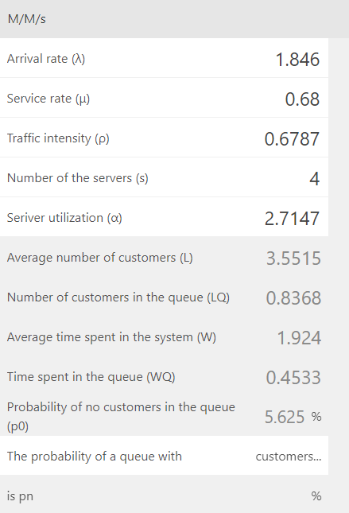
Quantitative analysis
For Photographers
Average time per order = (28% of orders * 3.5 hours) + (72% of orders * 0.667 hours)
= 1.4684
Service rate for a photographer = 1/1.4684 = 0.68 orders/hr
Typically, there are 0.83 customers waiting in line at Fotof. And the resource utilization for photographers is 67.87%

Slide 14
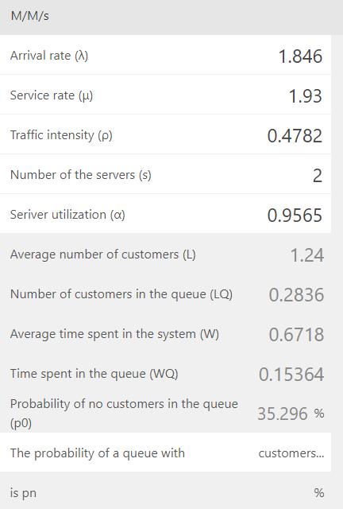
Quantitative analysis
For Technicians
The total number of technicians in all studios: 2 technicians/studio
Time spent on each order:
Clean-up and gallery preparation: 15 minutes/order
Additional editing for special requests: 30 minutes/order, but this is only required for 20% of orders, so the average additional editing time per order is 0.2 * 30 = 6 minutes/order
QA step: 10 minutes/order
Total time per order = 15 minutes/order + 6 minutes/order + 10 minutes/order = 31
minutes/order or approximately 0.5167 hours/order.
Service rate for a single technician: 1 / 0.5167 hours/order ≈ 1.935 orders/hour
On average, there are approximately 0.283 clients waiting in line at Fotof. And resource utilization is 47.82%.

Slide 15
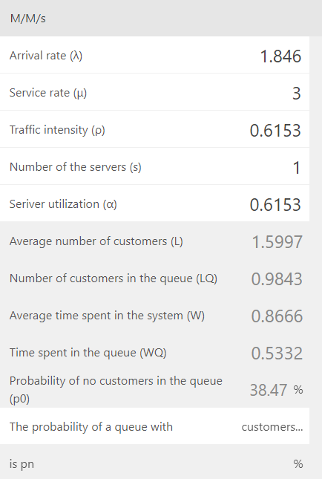
Quantitative analysis
For Customer Service Representative
Time spent on each order by a CSR is given as 20 minutes/order, which is equal to approximately 0.3333 hours/order.
Service rate for a single CSR: 1 / 0.3333 hours/order ≈ 3 orders/hour
Waiting time for the Customer Service Representative is 51 minutes with a 61.5% utilization.

Slide 16
Process Redesign
Online booking system
Redesign: Implement an online booking system on Fotof's website, allowing customers to easily enter their details and schedule their shooting sessions. The system should provide real-time availability for each studio, reducing the need for phone or email bookings. This is to try to capture all the needed information at once and at the source.
Reason: The problem of many late-shows and No-shows appointments is a significant concern as it results in the wastage of valuable time and resources. To tackle this issue, implementing an online reservation system would be beneficial. This system would automate reminders and provide convenient rescheduling options, resulting in a considerable decrease in the frequency of late-shows and no-shows.
Feasibility: While there is a significant upfront investment required to establish the system, the reduction in no-shows and the enhanced efficiency in managing bookings can help mitigate these initial costs

Slide 17
Process Redesign
Centralized Information Systems
Redesign: Implement centralized information systems such as cloud-based document repositories, knowledge bases, or enterprise resource planning (ERP) systems. These systems provide a single source of truth and enable geographically dispersed resources to access and share information seamlessly. For instance, the technician pool can be treated as if they were in central location further increasing efficiency and reducing wait time.
Reason: The problem of turnaround times between the photo shooting session and the availability of pictures for review is a leading customer complaint. To tackle this issue, implementing a consolidated pool of resources would be beneficial.
Feasibility: Medium to High. This requires an initial investment in developing the information system, but the decrease in customer complaints and increased customer satisfaction could offset this over time.

Slide 18
Process Redesign
Up-Selling Through Tagging Potential Customers
Redesign: Implement a tagging system on the photo gallery so customers can tag other people included in the photo. A link including the photo can be sent to the potential customer requesting if they would like to get a printed copy or if they would like a special order.
Reason: Management has expressed its desire to increase revenue, and this will be an avenue to prospect potential clients with a sneak peek of the services offered by Fotof..
Feasibility: Medium to High. This requires an initial investment in developing capability, but the increase in customer base would more than offset the cost.

Slide 19
Process Redesign
Customer portal
Redesign: Creating a customer portal that enables clients to track their order status, make payments, communicate specific requests, and access their digital photographs..
Reason: By implementing this solution, the company could experience a decline in customer inquiries and achieve a more efficient and streamlined communication process between the company and its customers.
Feasibility: Although there is an upfront cost involved in developing the portal, the long-term benefits of reduced customer service inquiries and increased customer satisfaction could eventually outweigh this initial investment.

Slide 20
Process Redesign
Automated Notifications and Reminders
Redesign: Developing an automated system that sends notifications and reminders to customers regarding their appointments, order statuses, and delivery updates.
Reason: Implementing this solution would result in a decrease in the volume of inquiries received by customer service and enhance the overall customer experience.
Feasibility: The expenses associated with implementing an automated system could be balanced out by the decrease in lost revenue caused by no-shows and late-shows

Slide 21
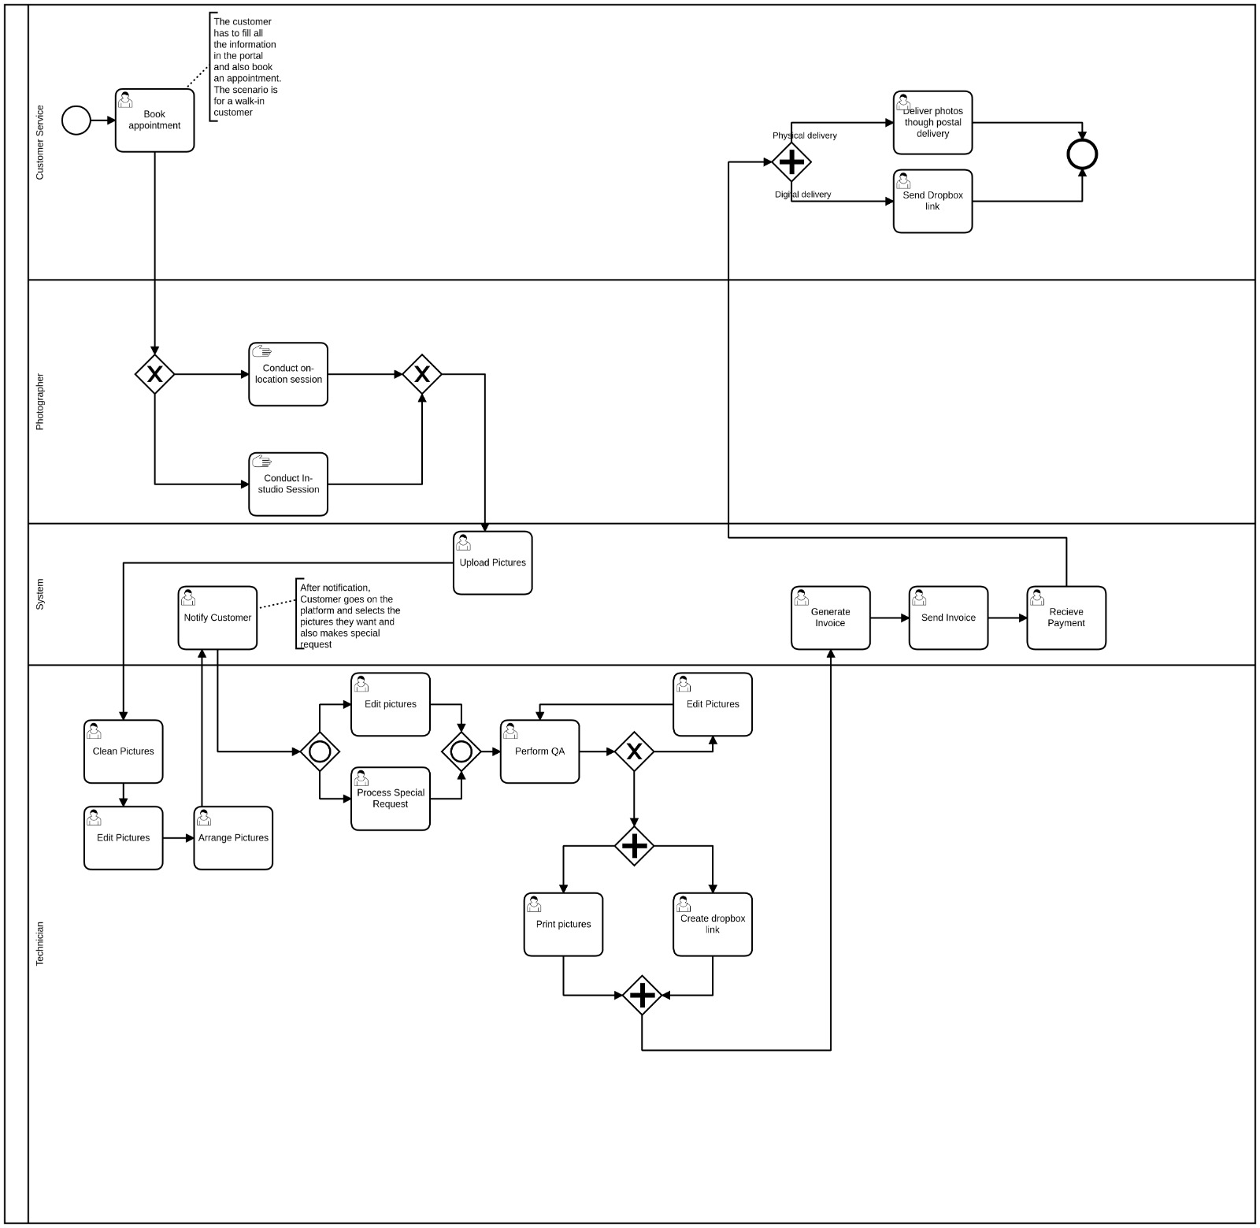

Slide 22
Questions?

Slide 23
Thank you

